Slide 1
English Premier League Game Predictions
Somsubhra Mukherjee 18210308
Sabyasachi Modak 18210389
Saiyyed Faizan Ahmed 18210956
Ashish Vijay Lakamale 18210227
Anup Bolli 18210820
Arun Ramakrishna 18210416
Notes:
We designed this template so that each member of the project team has a set of slides with its own theme where he/she can present their research. Members, here’s how you add a new slide to just your set:
Mark where you want to add the slide: Select an existing one in the Thumbnails pane, click the New Slide button, then choose a layout.
The new slide gets the same theme as the previous one you selected.
Careful! Don’t annoy your fellow presenters by accidentally changing their themes. That can happen if you choose a theme Variant from the Design tab, which changes all of the slides in your presentation to that look.

Slide 2
Can we predict an EPL Game Result?

Slide 3
Objectives
Perform exploratory analysis
Use concepts of data mining and machine learning to process the data
Predict the game result or FTR(HW,D,AW)

Slide 4
Data Understanding

Slide 5
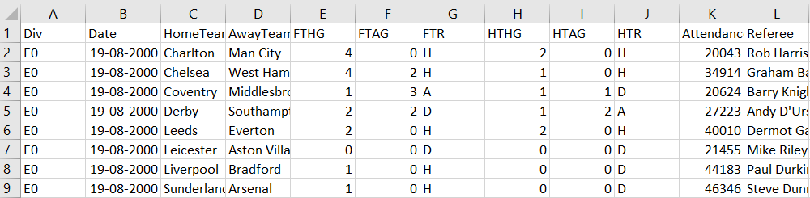
Data Description
Dataset Source – EPL Results from Football Data UK* (“csv” format)
18 seasons (Season 2000-2001 to Season 2017-2018)
Numerical data – (FTHG,FTAG,Attendance,HS,AS,HST,AST,AY,AR,etc..)
Categorical data – (HomeTeam,AwayTeam,Referee,HTR,FTR)
*http://www.football-data.co.uk/

Slide 6
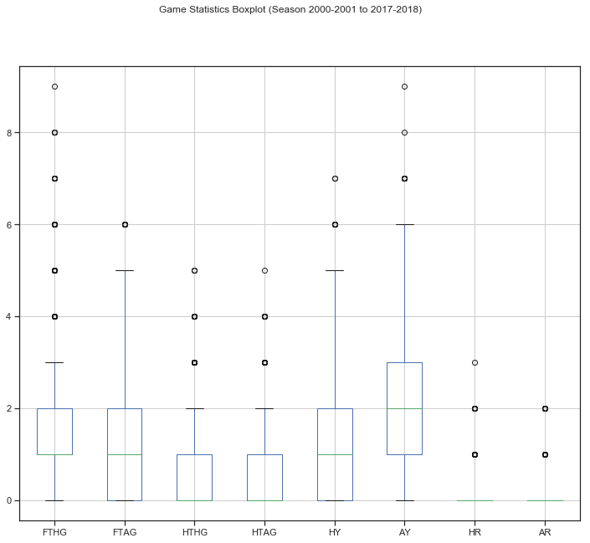
Visualising the data

Slide 7
Data Preparation

Slide 8
Handling Missing Values?
Dropped Columns with Missing values
B365H
B365A
B365D

Slide 9
Feature Engineering
Aggregated Features – How strong a team is in attack and defense ?
HAS – Home Attacking Strength
HDS – Home Defensive Strength
AAS – Away Attacking Strength
ADS – Away Defensive Strength
Dynamically generated Features – How good or bad is a team’s form coming in the match ?
ATP – Away team point
HTP - Home team goal point
ATGD – Away team goal difference
HTGD – Home team goal difference
DiffPts – Difference in Aggregated Points
DiffFromPts – Difference in Form

Slide 10
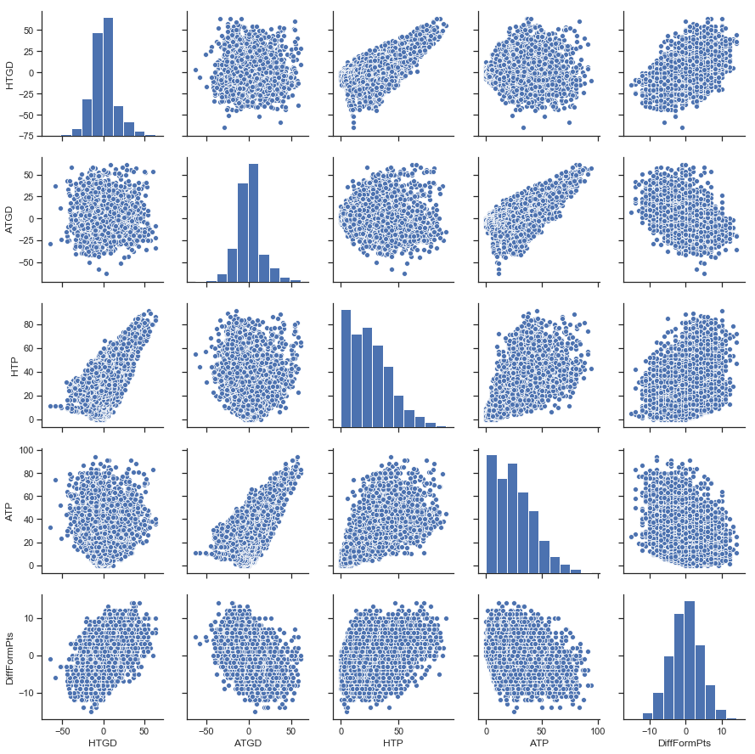
Visualising Features

Slide 11
Feature Elimination
Data Integration
Combined the new features with the original features.
Feature Table contains all the refined features.
FTR (Full Time Result) – Categorical to Numerical. (HW = +1, D = 0, AW= -1)
Recursive Feature Elimination with Cross Validation
Ensemble Methods:
Extra Trees Classifier
Random Forest Classifier

Slide 12
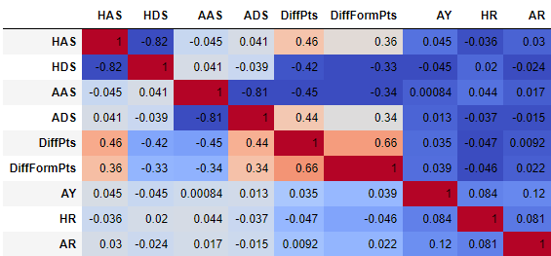
Feature Correlation

Slide 13
Modelling

Slide 14
Logistic Regression

Slide 15
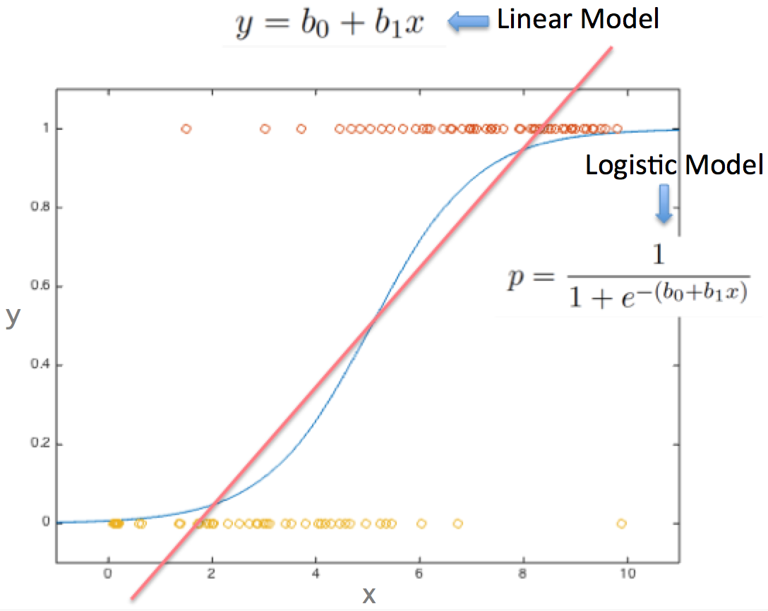
Logistic Regression
Logistic regression is a regression model where the dependent variable is categorical.
Measures the relationship between dependent variable and independent variables by estimating probabilities
Notes:
Logistic regression measures the relationship between the categorical dependent variable and one or more independent variables by estimating probabilities using a logistic function
Logistic regression can be seen as a special case of generalized linear model and thus analogous to linear regression. The model of logistic regression, however, is based on quite different assumptions (about the relationship between dependent and independent variables) from those of linear regression. In particular the key differences of these two models can be seen in the following two features of logistic regression. First, the conditional distribution y \mid x is a Bernoulli distribution rather than a Gaussian distribution, because the dependent variable is binary. Second, the predicted values are probabilities and are therefore restricted to (0,1) through the logistic distribution function because logistic regression predicts the probability of particular outcomes.

Slide 16
Logistic Regression
 | Prediction
Truth |  | -1 | 0 | 1
 | -1 | 252 | 3 | 217
 | 0 | 123 | 6 | 312
 | 1 | 101 | 4 | 685
 | Accuracy
Overall | 55 %
Target = -1 | 53 %
Target = 0 | 1 %
Target = 1 | 87 %
Target 1 : Home Team Win Target 0 : Draw Target -1 : Away Team Win

Slide 17
Support Vector Machine

Slide 18
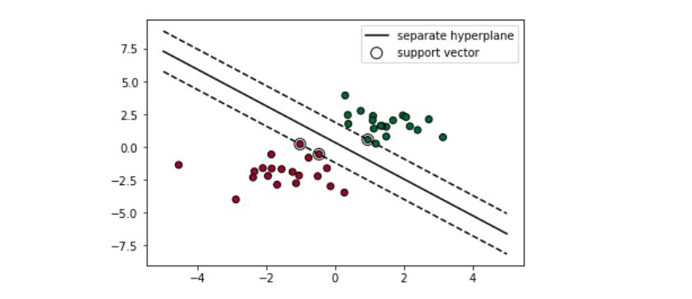
Support Vector Machine
Support Vector Machine is responsible for finding the decision boundary to separate different classes and maximize the margin.
SVM in linear separable cases.
SVM in linear non-separable cases.
Soft Margin
Kernel Trick

Slide 19
Support Vector Machine
GridSearchCV : used for cross validation and parameter tuning.
Best parameters found for Model:
Best C : 1000
Best Kernel : RBF (Radial Basis Function)
Best Gamma :0.0001
 | Prediction
Truth |  | -1 | 0 | 1
 | -1 | 315 | 10 | 254
 | 0 | 152 | 14 | 358
 | 1 | 112 | 8 | 829
 | Accuracy
Overall | 56 %
Target = -1 (AW) | 54 %
Target = 0 (D) | 3 %
Target = 1 (HW) | 87 %
Target 1 : Home Team Win Target 0 : Draw Target -1 : Away Team Win

Slide 20
Extreme Gradient Boosting

Slide 21
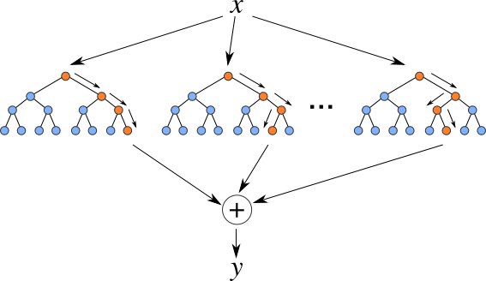
XGBoost
Not a specific machine learning algorithm.
Meta-Algorithm
Ensemble Algorithm
Boosting converts a collection of weak learners into a strong learner.
Notes:
Xgb is another tree model，actually it is a very popular tool in data mining due to its extremely fast speed and high performance.
As a tree model, xgb can do parallel computation, 10 times faster than Random forest.
It is an additive tree model based on greedy method. In each step, a new tree is added to compliment the already built Trees. This normally gives you better accuracy with more trees. The final response is the weighted sum of all predictions from each individual trees or we can say it is the optimal linear combination of all decision trees.
For each decision tree, features flowing into the tree will finally reach the leaf by the binary critraten , we do not need to do careful features normalization. -----suitable for cate data
These two advantage makes it an ideal model in our case:
fast spead , handle large scale dataset--------
Handle cate ----anonymous features with cate and num var combined.

Slide 22
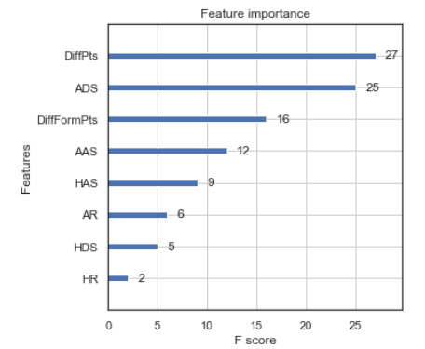
Feature Importance and Validation
Available in the feature_importances_ member variable
The F-Score is a single measure of a classification procedure’s usefulness.
It considers both Precision and the Recall of the procedure to compute the score.
Accuracy | Metric
Overall | 79.0%
F1 Score | 0.7
Notes:
Xgb result
Left:
error rate with the increase of number of tree
the error decrease with more trees added,
Right: auc increase with more tree added
For xgboost, parameter tuning can give us significant improvement on accuracy the best result compare other method.

Slide 23
Evaluation

Slide 24
Method Comparison

Slide 25
Thank You

